Slide 1
To look forward to
Part 3: Rev 19:1-10
Preached by Dr. Jim Harmeling at Crossroads International Church Singapore • cicfamily.com Uploaded by Dr. Rick Griffith • Singapore Bible College Files in many languages for free download at BibleStudyDownloads.org

Slide 2
To look forward to
Fixing our sight on God’s revelation of the future

Slide 3
Question 1: How do I look forward to the future when life looks like it will get worse and not better?
Question 2: How do I look forward to the future when something horrible happens without any warning?

Slide 4
Question 3: What kind of future am I looking forward to?

Slide 5
1 Jesus is here!
2-3 Churches get ready!
4-18 Global judgment

Slide 6
Matthew 24:21-22
²¹ For then there will be great tribulation, such as has not been from the beginning of the world until now, no, and never will be. ²² And if those days had not been cut short, no human being would be saved. But for the sake of the elect those days will be cut short.

Slide 7
Increased Uncovering of End Times
Daniel
Matthew 24
Revelation
7 Years of divine judgment on earth

Slide 8
BAD NEWS
God’s global judgment is coming
and nothing will stop it
GOOD NEWS
Jesus rescues believers from this global judgment

Slide 9
Philippians 3:20-21
²⁰ But our citizenship is in heaven, and from it we await a Savior, the Lord Jesus Christ, ²¹ who will transform our lowly body to be like his glorious body, by the power that enables him even to subject all things to himself.

Slide 10
Rejoice! Evil is Defeated (vs. 1-5)
Salvation
Glory
Power

Slide 11
“God is praised because salvation, glory and power belong to him. Each of these three great attributes of God should awaken its own response in the heart of man. The salvation of God should awaken the gratitude of man; the glory of God should awaken the reverence of man; the power of God is always exercised in the love of God and should, therefore, awaken the trust of man. Gratitude, reverence, trust-these are the constituent elements of real praise.”
William Barclay

Slide 12
Rejoice! Evil is Defeated (vs. 1-5)
Salvation = gratitude
Glory = reverence
Power = trust

Slide 13
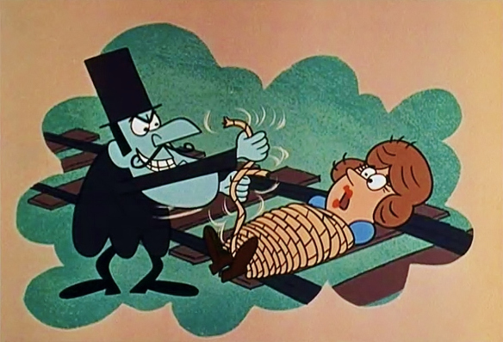
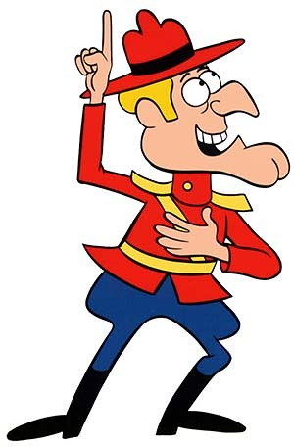
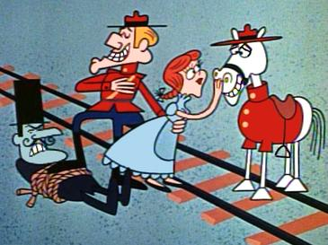

Slide 14
Rejoice! Evil is Defeated (vs. 1-5)
Rejoice! The King Reigns and His Bride is Ready (vs. 6-8)

Slide 15
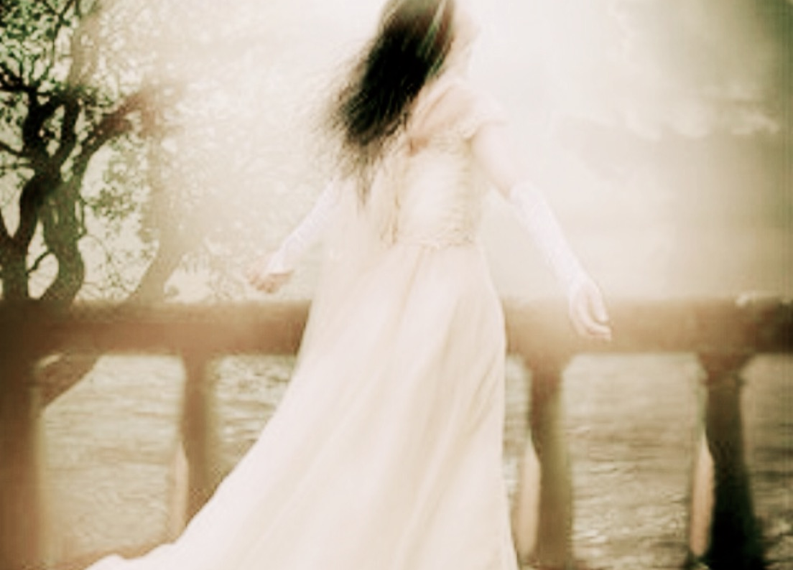
Marriage
Bride
Ready
Fine linen,
Bright & pure
2 Corinthians 11:4
“For I feel a divine jealousy for you, since I betrothed you to one husband, to present you as a pure virgin to Christ.”

Slide 16
“Blessed are those who are invited to the marriage supper of the Lamb”

Slide 17
Colossians 3:1-2
¹ If then you have been raised with Christ, seek the things that are above, where Christ is, seated at the right hand of God. ² Set your minds on things that are above, not on things that are on earth.

Slide 18
Ephesians 1:13-14
¹³ In him you also, when you heard the word of truth, the gospel of your salvation, and believed in him, were sealed with the promised Holy Spirit, ¹⁴ who is the guarantee of our inheritance until we acquire possession of it, to the praise of his glory.

Slide 19
Matthew 22:1-13

Slide 20
Black

Slide 21
Topical Preaching link at BibleStudyDownloads.org
Get this presentation for free!
Notes:
The Bible…Basically (bb)

